Slide 1

Introduction Video

Slide 2

SCHOOL COUNSELORS AND STUDENTS’CAREER CHOICE
Elisa Coren
http://elisacoren.angelfire.com/index.html
COUN 511 Spring 2009
Picture: Source www.trueu.org

Slide 3
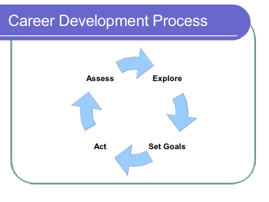
What is Career Choice?
Career choice is the act of selecting an occupation.
Selection is made through the process of career development.
  Lifelong process that allows one to:
    Assess skills, interest, abilities, and personality
    Explore career options
    Set career goals and plan how to achieve career goals
    Act out goals and plan.
Picture Source: www.dcs.wisc.edu/info/images/careerprocess.png

Slide 4



Topics of Career Choice that Counselors will deal with are:
Interests, Abilities, Skills, and Personality Assessments
Career Exploration
College Planning
Resume and Cover Letter Writing
Networking and Interviewing

Slide 5
What can Counselors do?
Easiest way to get information about career choice and development out to the school community is through a webpage that has:
  External Links
  Self-assessments
  Activities
  College information
  Career Profiles

Slide 6

Career Choice Address Book
I researched 22 websites that counselors can use to assist with career choice with students.
  Internet Address Book

Slide 7
WEBSITES BREAKDOWN

Slide 8
Website Categories
The websites classified into four categories.
  Commercial
  Nonprofit organizations
  Professional organizations
  Government

Slide 9

Audience Members
Counselors
Students
Parents & Family
Teachers

Slide 10

Website Analysis
The websites in the internet address book were analyzed according to the following criteria:
  Content Scope
  Content Quality
  Ease of Use
  External Link Value
  Overall Rating

Slide 11
Commercial Websites

Slide 12
Nonprofit Organizations Websites

Slide 13
Professional Organizations

Slide 14
Government Websites

Slide 15

Examples of Website Information
To view examples of information that can be found on the websites access:
  Excerpts

Slide 16

Virtual Tour of Top 3 Sites
To take a virtual tour of my top 3 websites….
  Click Here

